Slide 1
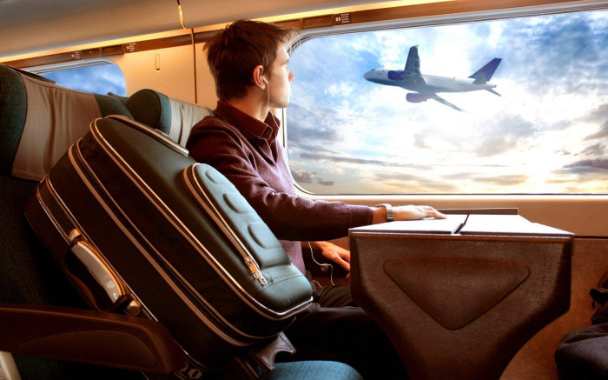
VALUE ADDED COURSE
PROJECT PPT PRESENTATION
COURSE:
FULL STACK WEB DEVELOPMENT.
TOPIC:
TRAVEL WEBSITE USING HTML,CSS,JS & BOOTSTRAP.
Team Members 1.D.Akash. 2.M.DeepakShiva. 3.P.Arunkumar.

Slide 2
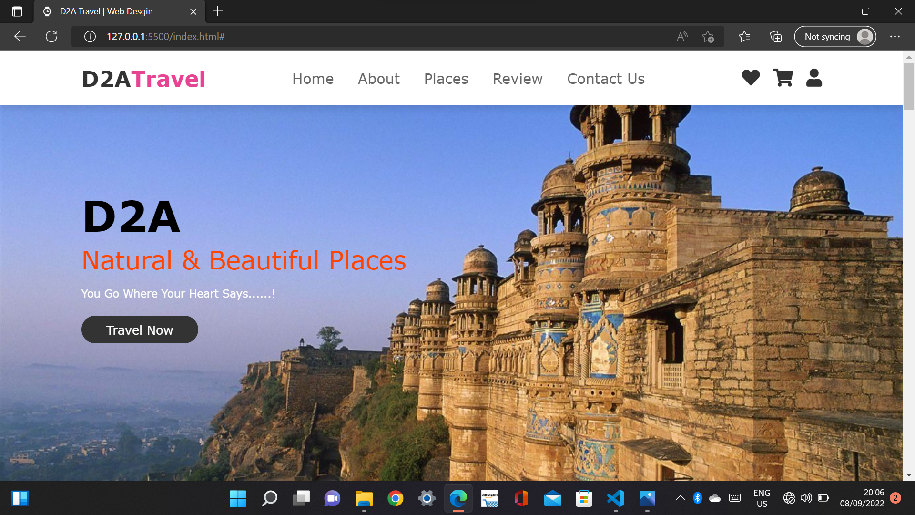
Project Preview

Slide 3
1.HomePage.
Home page consist of:
@Main image,
@Logo,
@Navbar,
@Travel Button,
@Add to cart button,
@Profile

Slide 4
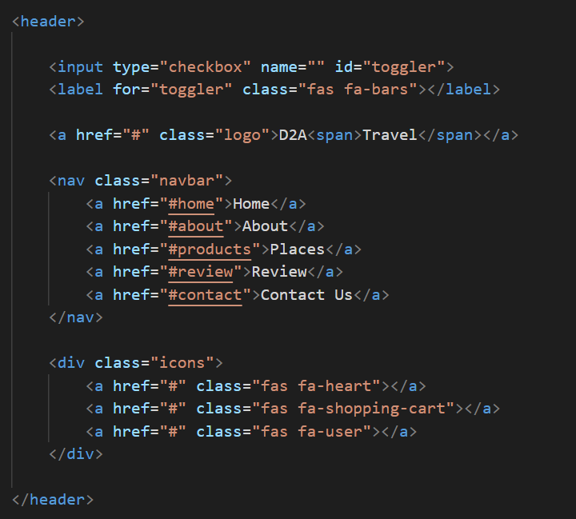
2.Navigation Bar.
Code:

Slide 5
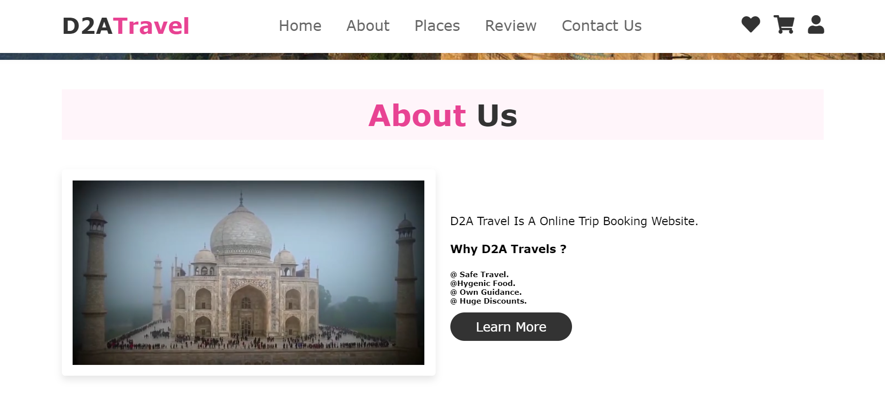
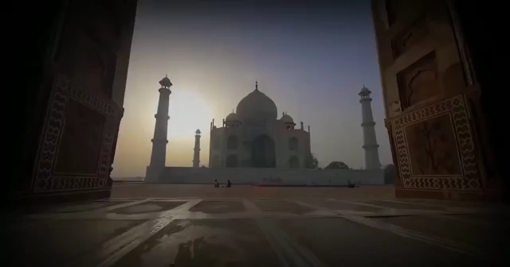
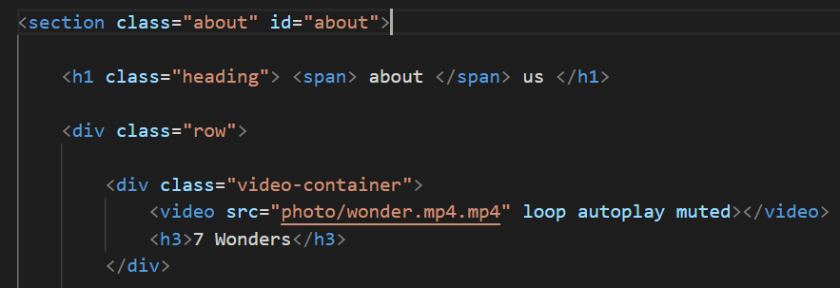
3.About Us.
Code for Video:

Slide 6
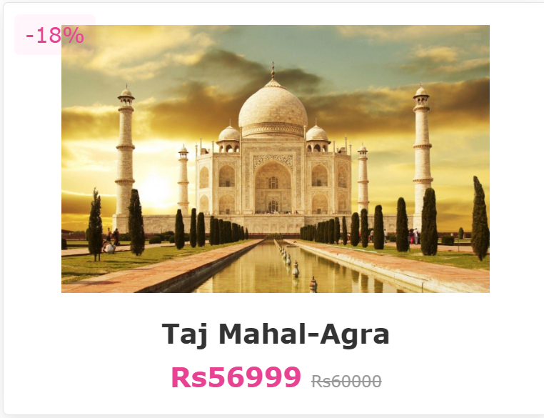
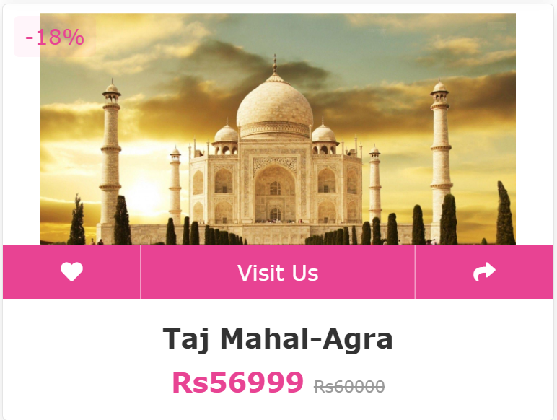
4.Images.
Before Hover Effect
After Hover Effect

Slide 7
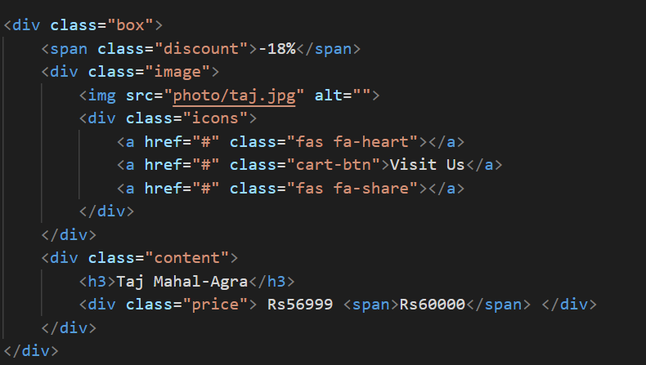
Code for Image:

Slide 8
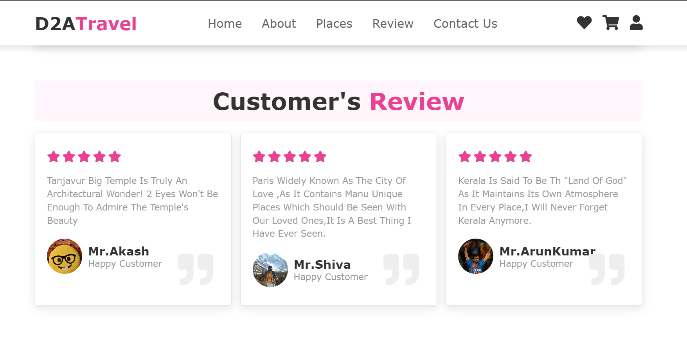
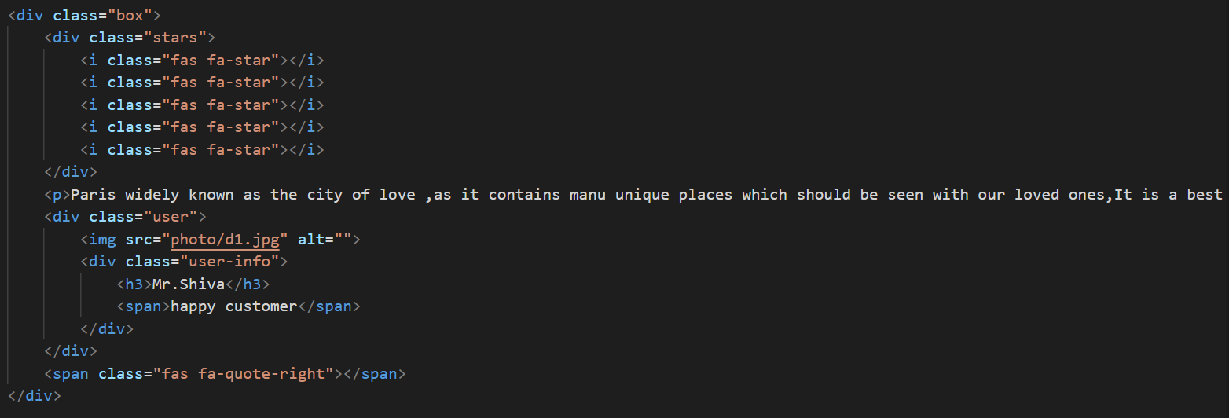
4.Customer Review:
Code For Review

Slide 9
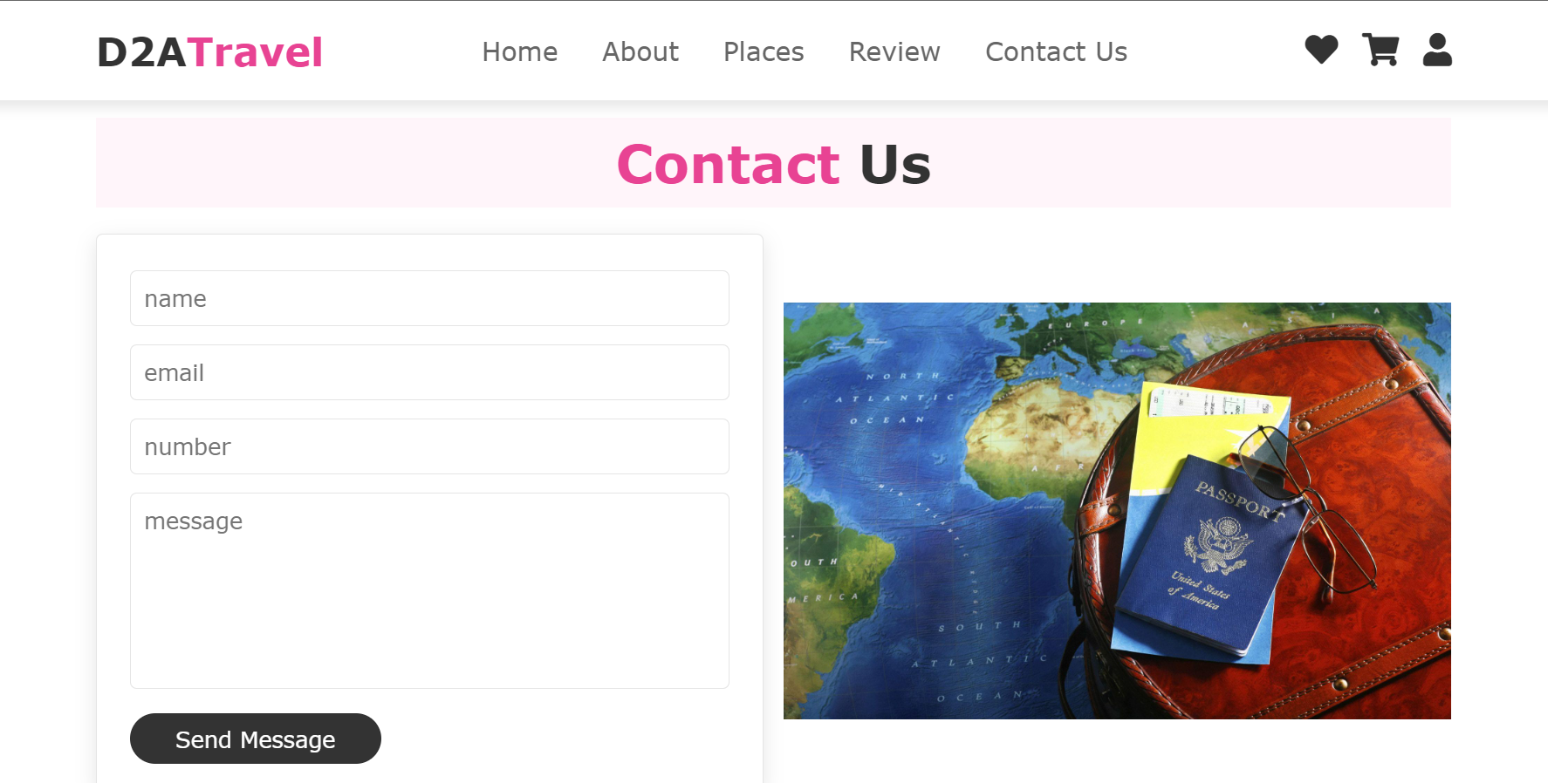
5.Contact Form.

Slide 10
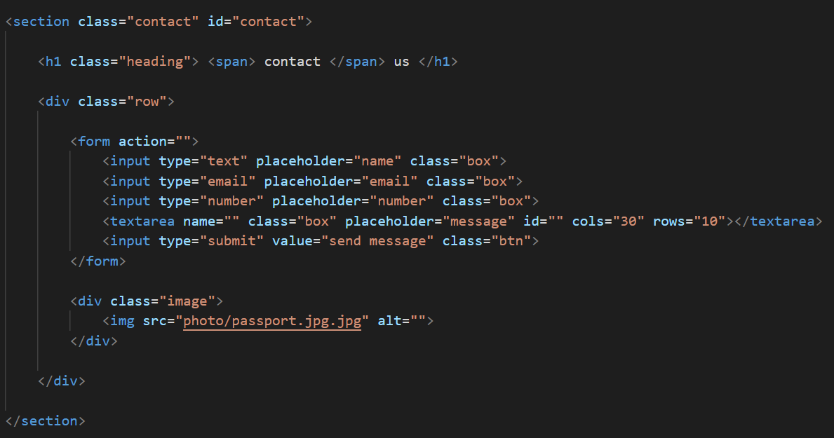
Code For Contact Form:

Slide 11
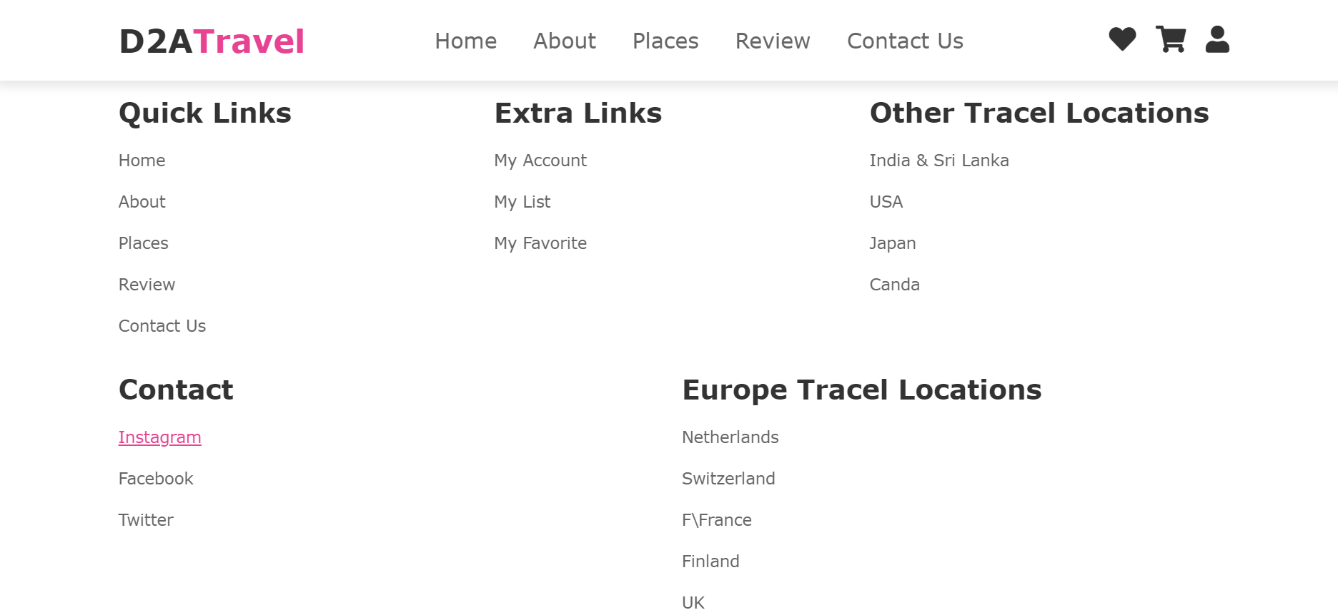
6.Hyperlinks.

Slide 12
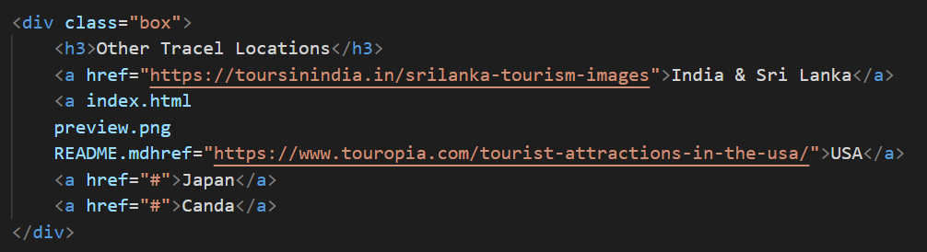
Code For Hyper Links:

Slide 13
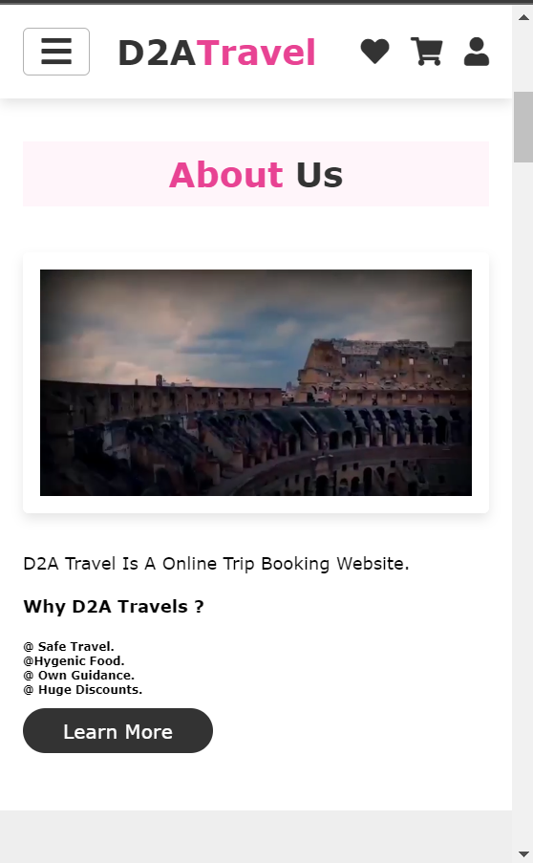
7.Responsive Webpage.
Webpages can be made Responsive using Media Queries , So that the webpage can be used in all types of End Devices such as Mobile , Tablet and Laptops.
A . Mobile Resolution
B . Laptop Resolution

Slide 14
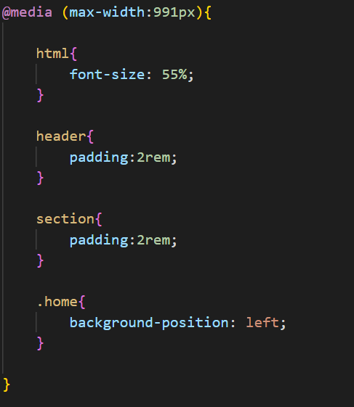
Code For Responsive Website:

Slide 15

For Your Kind Co-operation

